Slide 1

Smart Medical Inventory and Equipment Management System CSA0206 - C-programming
Guided by:
Dr. V. Karpagam Presented By :
Jerlin J (192312313)
T. Pravallika (192525189)
P. Geethanjali (192412372)

Slide 2


INTRODUCTION
Tracks medicines, stock levels, expiry dates, and medical equipment in a centralized system.
Provides real-time inventory updates to maintain accurate stock records.
Generates alerts for low stock and medicines nearing expiry to prevent shortages and wastage.
Monitors the availability and maintenance of medical equipment for efficient healthcare operations.
Reduces manual errors, improves inventory management, and enhances patient care through automation.

Slide 3
LITERATURE REVIEW
Authors&Year | Title | Method | Finding | Gap
Li et al. (2024) | Smart Hospital Inventory System | Multi-Agent Reinforcement Learning | Improved medicine availability and reduced inventory costs. | No medical equipment tracking.
Walczyk et al. (2024) | Automated Drug Inventory | Inventory model comparison | Reduced expired medicines and improved stock control. | Focused only on medicine cabinets.
Bekele et al. (2025) | Essential Medicine Inventory | Cross-sectional study | Improved stock management and reduced stock-outs. | Did not include equipment management.
Abu Zwaida et al. (2025) | AI-Based Drug Inventory | Deep Reinforcement Learning | Optimized medicine stock and minimized shortages. | Expiry monitoring and equipment tracking were not included.
MDPI Review (2026 | AI in Healthcare Inventory | Systematic Literature Review | AI improved demand forecasting and inventory efficiency. | Lacks a fully integrated system for medicines and equipment.

Slide 4
PROBLEM STATEMENT
Manual inventory management leads to inaccurate records and frequent human errors.
Expired medicines may remain in stock due to the lack of proper expiry tracking.
Medicine shortages or overstocking occur because stock levels are not monitored effectively.
Medical equipment is difficult to track, resulting in misplacement, unavailability, or delayed maintenance.
Lack of real-time monitoring reduces operational efficiency and can affect the quality of patient care.

Slide 5
OBJECTIVES
To develop a centralized system for managing medicines and medical equipment.
To monitor medicine stock levels in real time and maintain accurate inventory records.
To track medicine expiry dates and generate alerts to reduce wastage.
To monitor the availability and maintenance status of medical equipment.
To improve inventory management by reducing manual errors and ensuring timely availability of medicines and equipment.

Slide 6
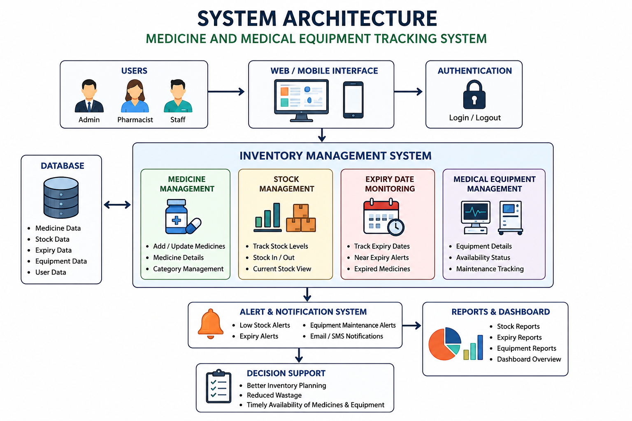
System Architechture:

Slide 7
Module-1: Requirement Analysis Module
Collect user requirements from hospitals, pharmacies, and administrators.
Analyze the existing inventory system to identify current problems and limitations.
Define system requirements for medicine, stock, expiry, and equipment tracking.
Identify hardware and software requirements needed for system development.
Prepare the Software Requirements Specification (SRS) to guide the design and implementation of the system.

Slide 8
Module-2:Processing and display Module
Process medicine and medical equipment data entered by the user.
Update stock levels automatically when items are added or issued.
Monitor expiry dates and identify near-expiry or expired medicines.
Display real-time inventory status through a user-friendly dashboard.
Generate alerts and notifications for low stock, expiry, and equipment maintenance.
Produce reports for medicines, stock availability, expiry status, and medical equipment.

Slide 9
Module-3: Inventory Monitoring and Report Generation
Monitor medicine stock levels continuously to ensure adequate availability.
Identify low-stock, out-of-stock, and expired medicines for timely action.
Track the availability, usage, and maintenance schedule of medical equipment.
Generate inventory reports, stock summaries, and equipment status reports.
Provide alerts for medicine restocking, expiry dates, and equipment servicing.
Maintain accurate inventory records to support efficient hospital and pharmacy management.

Slide 10
CONCLUSION
Provides an efficient and centralized system for managing medicines and medical equipment.
Ensures accurate tracking of stock levels, expiry dates, and equipment availability.
Reduces manual errors, medicine wastage, and inventory shortages through automation.
Improves operational efficiency by generating real-time alerts, reports, and inventory updates.
Enhances healthcare services by ensuring the timely availability of medicines and medical equipment for better patient care.

Slide 11


